Slide 1


Connect devices to the cloud
Pamela Cortez |
Hardware Ecosystem Engagements & Communities Senior PM, Azure IoT
@AltaOhms
/in/pamelacortezhellotechie

Slide 2
Build end to end IoT Solutions
1. Transform your business with IoT
2. Connect devices to the cloud
3. Provision devices at scale
4. Understand IoT message processing, analytics, and business integration
5. Build the intelligent edge
6. Build IoT solutions with Azure IoT Central
Notes:
Transform your business with IoT
To start this series, we’ll explain how the Internet of Things (IoT) addresses the problems of efficiency, productivity, safety, and security. We’ll describe Azure IoT components and explain how you combine them to create value for enterprises, enabling digital feedback loops for solutions that extend beyond telemetry with analytics and edge solutions that provide real-time status.
Create an Azure dashboard and resource group.
Create an IoT hub using the Azure portal.
Examine features of Azure IoT Hub.
Create a device provisioning service and link it to your IoT hub.
Connect devices to the cloud
In this session, you’ll learn how to set up the development environment used throughout this series. We’ll cover how to connect an IoT device that includes temperature and humidity sensors to Azure. In the labs, you’ll configure a simulated device to connect to Azure IoT Hub. Then you’ll run the simulated device to send telemetry messages and verify that device telemetry is being received.
Provision devices at Scale
This portion of the workshop walks through a hypothetical asset-monitoring solution that requires IoT devices with sensors for tracking location, temperature, and pressure to be placed in product transport boxes. When a new box enters the system, it is equipped with the new IoT device. The device needs to be autoprovisioned to the IoT hub using Azure’s device provisioning service. When the box arrives, the sensor is removed from the box and needs to be “decommissioned” through the device provisioning service. You’ll learn how you can use the device provisioning service to enroll many devices automatically and securely using X.509 certificate authentication.
Understand IoT message processing analytics and business integration
Preventive maintenance is a key IoT scenario—detect that something is wrong before there is any damage. In this module, you’ll write code to send continuous telemetry to an IoT hub that will use Azure Stream Analytics and a built-in machine learning model to warn of anomalies. Using Power BI to visualize the data stream, you’ll create an event subscription within Azure IoT Hub to set up Azure Event Grid integration that will trigger a logic app to send an alert. We’ll also cover working with time series data using Azure Time Series Insights.
Build the intelligent edge
With the collection of large amounts of data and the need for urgent responses, you’ll want to bring the intelligence to the edge for processing data and only send the important data to the cloud. We’ll take a deep dive on using an Azure IoT Edge device as a gateway and you’ll learn the different scenarios where an IoT Edge device is on an enterprise network (needs proxy settings) or needs extended offline capabilities.
Build solutions with IoT Central
Designed to enable the easy monitoring and management of a fleet of devices, Azure IoT Central encompasses a range of underlying technologies that work together well but can be complicated to implement when many technologies are needed. These technologies include Azure IoT Hub, the Azure device provisioning service, Azure Maps, and others. We’ll also take a look at IoT Plug and Play to interact with a device's capabilities even without knowledge of the underlying device implementation.

Slide 3
Agenda
What is Azure IoT Hub
Connectivity Models
Communication Protocols
Azure IoT SDKs
Azure IoT Hub Message
Device Update for IoT Hub
Tooling
DEMO: Azure IoT Hub Walkthrough
Resources
Live Q&A

Slide 4




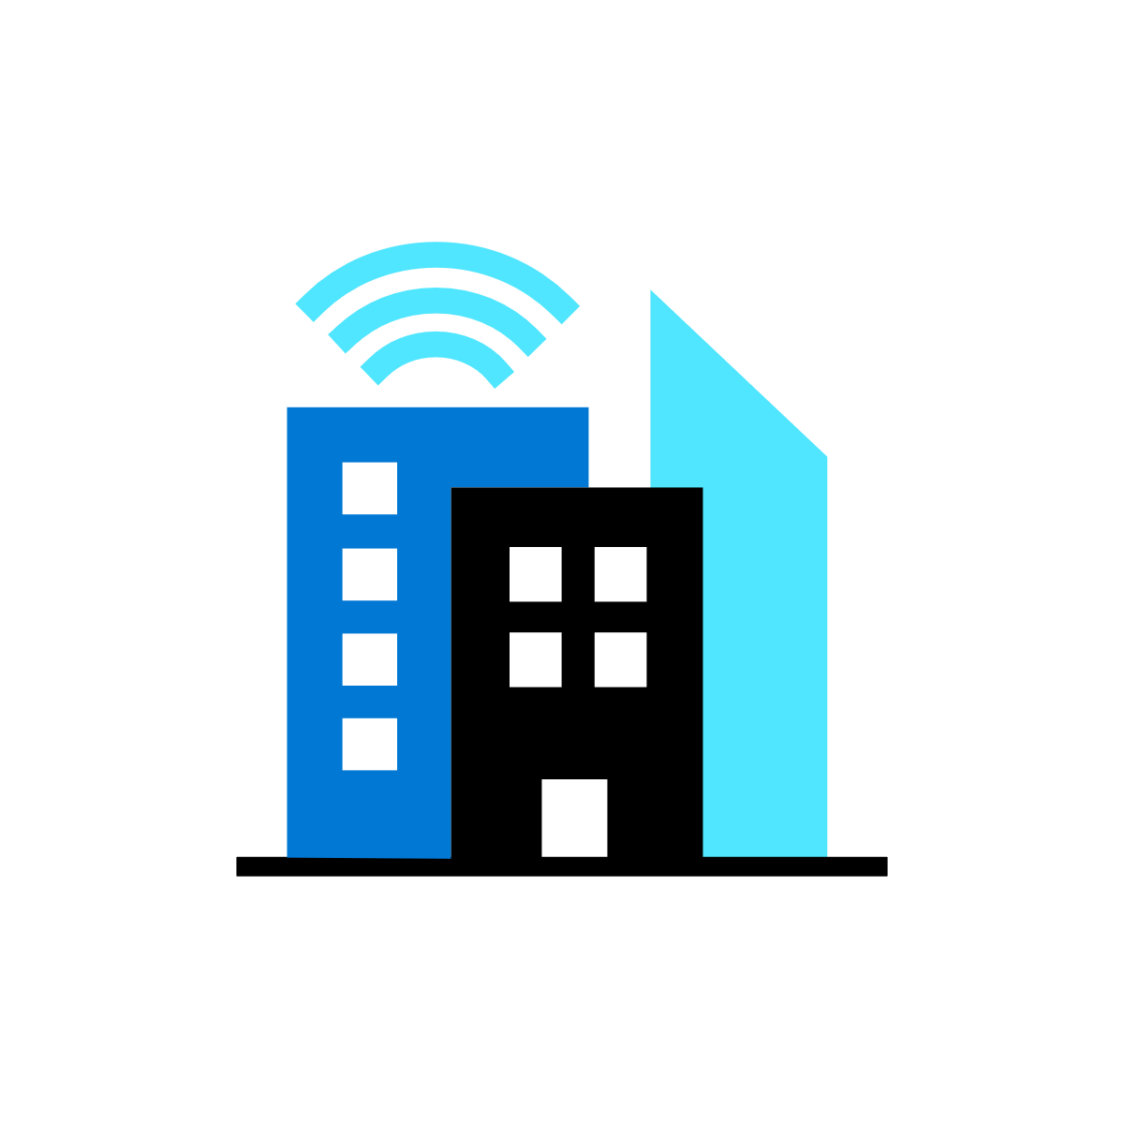

Microsoft’s comprehensive IoT product portfolio
→ aka.ms/mslearniot
Azure IoT priority verticals
Manufacturing | Retail | Agriculture | Energy | Smart Cities | Healthcare | Transportation
Azure IoT Central
(SaaS)
Azure IoT Reference Architecture & Accelerators (PaaS)
Dynamics Connected
Field Service
(SaaS)
Azure IoT Solutions
Azure IoT Hub
Azure IoT Hub Device Provisioning Service
Azure Digital Twins
Azure Time Series Insights
Azure Maps
Azure Stream Analytics
Azure Cosmos DB
Azure AI
Azure Cognitive Services
Azure ML
Azure Logic Apps
Azure Active Directory
Azure Monitor
Azure DevOps
Power BI
Azure Data Share
Azure Spatial Anchors
Azure Defender
for IoT
Azure Services for IoT
Azure RTOS
Azure Sphere
Azure IoT Device SDK
Azure IoT Edge
Azure Stack Edge
Windows IoT
Azure Certified for IoT—Device Catalog
Azure Stream Analytics
Azure Storage
Azure ML
Azure SQL
Azure Functions
Azure Cognitive Services
IoT & Edge
Device Support

Slide 5


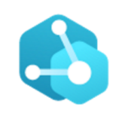
Develop with choice
Digital Twins
Azure IoT Central
Azure IoT Hub
The easiest and most cost-effective way to connect and manage devices at scale, and time to results.
Enable highly secure, flexible and reliable communication from the cloud to the edge.
Create comprehensive digital models of entire environments.³
1000+ Azure IoT Devices certified¹
150 billion messages per month via IoT Hub²
Gartner includes Microsoft as a Digital-Twin-Enabled Application Provider³
1 Placeholder Source; 2 Placeholder Source; 3 Gartner: Market Guide for Digital Twin Portfolios and Enabling Technologies (Jan 2020)
Notes:
Azure IoT Central is the easiest and most cost-effective way to connect and manage devices at scale. It connects your IoT devices to the cloud faster than any other platform. You can find new devices matched to your solution in the Azure Certified for IoT device catalog. Also, we understand how hard it is to keep devices connected and healthy. Azure IoT Central lets you reconfigure and update devices with centralized device management. In addition, the connectors and extensibility APIs bridge the gap between your business applications and IoT solution.
Azure IoT Hub is a Platform as a Service. With it you can do the following:
Establish bi-directional communication with billions of IoT devices
Enhance security with per device authentication
Provision devices at scale with IoT Hub Device Provisioning Service
Manage devices at scale with device management
Use multi-language and open source SDKs
A Digital Twin (DT) is a dynamic digital representation of a physical piece of equipment, or thing, and its associated environment. Every DT has a dynamic data model containing only a few, or even thousands, of data attributes of the physical thing or system it represents. Attributes are associated with sensors that are measuring temperature, pressure, and other variables and associated physics in order to represent real-world operating conditions as well as static values like the installation date or OEM. Azure Digital Twins is the development platform for IoT solutions that model the real world.

Slide 6


IoT Hub and Device Provisioning Service
Device Provisioning Service
Azure IoT Hub
Bi-directional communication
Enterprise scale & integration
End-to-end security
IoT-scale automated provisioning
Millions of Devices
Multi-language, open source SDKs
HTTPS/AMQPS/MQTTS
Send Telemetry
Receive Commands
Device Management
Device Twins
Queries & Jobs
Billions of messages
Scale up and down
Declarative Message Routes
File Upload
WebSockets & Multiplexing
Azure Monitor
Azure Resource Health
Configuration Management
Per Device Certificates
Per Device Enable/Disable
TLS Security
X.509 Support
IP Whitelisting/Blacklisting
Shared Access Polices
Firmware/Software Updates
Azure Defender Support
Zero-touch provisioning
Centralize your provisioning workflow
Load balance across multiple IoT Hubs
Re-provisioning support
Supports TPM + X.509
Notes:
Per device authentication

Slide 7

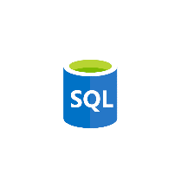


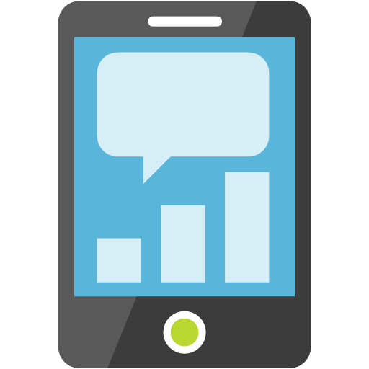






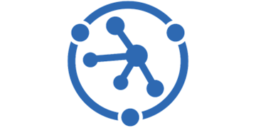

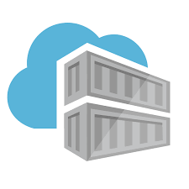



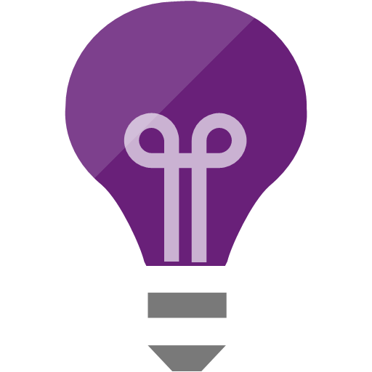


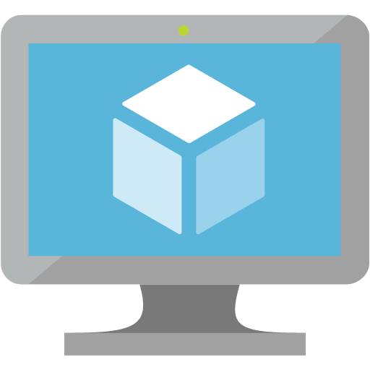
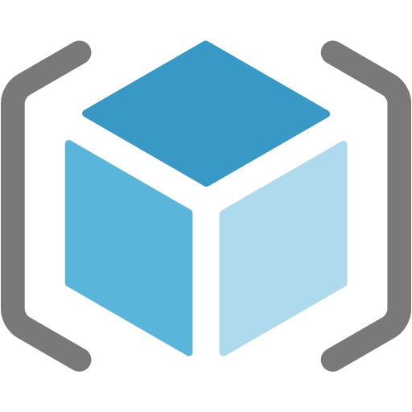


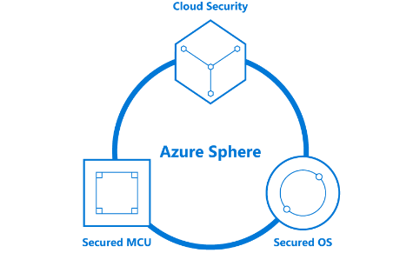
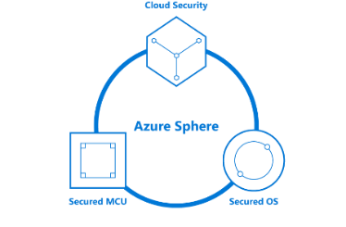
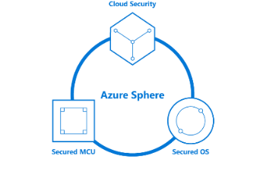




Your options for building IoT solutions
Option 1. Build from the ground up with platform as a service options (Lego blocks)
THINGS
INSIGHTS
ACTION
Gain real time insights and improve business processes
Identify patterns in data, automate rules & alerts
Optimize operations, increase profitability, & create more compelling business models
Manage
View and manage solutions
Azure IoT Device SDK
3rd Party Industry specific sensors & devices
(RTOS, Linux, Windows, Android, iOS)
Functions
SQL Azure
Web Apps
Power BI
Mobile Apps
Edge Modules:
Protocol Adaptation
Functions
Stream Analytics
Machine Learning
AI
Event Hub
Maps
IoT Hub
PowerApps
Web Apps
Azure IoT Edge
Device Provisioning Service
Time Series Insights
Key Vault
Business Integration
Connect to business apps & services
Container
Registry
Azure Stream
Analytics
Cosmos DB
Data Explorer
Application Insights
Dynamics 365
Kubernetes Service
Office 365
Azure Sphere
Compute (VMs)
Content Delivery Network
Storage
Resource Manager (ARM)
3rd Party applications
Domain Name System
Microsoft Flow
Secured MCU
Secured OS
Cloud Security
Service Bus
Front Door
Integrated view for CISO & SecOps personas to review enterprise security posture, including IoT solutions.
Holistic view of IoT solution security posture for DevOps and IoT solution managers to review and manage day to day security status
Azure Defender for IoT
Notes:
Azure IoT Hub and Azure Digital Twins provide the building blocks for companies to construct customized IoT solutions
The right fit for businesses with cloud solution and device expertise (in-house or through partnerships) who want to fine-tune their services with a high degree of control and customization
You can connect devices to IoT Hub
Azure IoT Central enables companies to get started quickly building IoT applications with a fully-managed IoT solution offering.
The right fit for businesses that do not wish to dedicate extensive resources to system architecture and want to select a solution that provides predictable pricing and the ability to customize branding, device types, data management and user roles.
Questions to ask yourself on which choice to take:
1) Expertise: How proficient are you with building cloud solutions
2) Control: What elements of my solution do I want to customize
3) Pricing: What structure best fits your needs?

Slide 8
IoT Solution Architecture
IoT Devices
Custom
Protocols
Custom
Cloud Gateways
UI & reporting Tools
Configure and control
Visualize data and learnings
Constrained Devices
Field Gateways
Constrained Devices
Cloud Gateway (IoT Hub)
Stream Processing
Business Integration
Stream processing and
rules evaluations over data
Edge Devices
Intelligent
Edge
Edge Devices
Data Transformation
Machine Learning
Storage
Cold
Path store
Warm
Path store
IoT Devices
IP Capable devices
send data from devices to Cloud
Store data
Integrate with Business process
Things
Insights
Actions
Notes:
Quick recap from the Deciphering Data Introduction session
Things :
Directly connected, via a gateway, or intelligent edge devices
If you are a device developer you need to be thinking about message types, data types, serialisation, and metadata as these simply data processing in the cloud.
Insights
Stream processing, data transformation, and Storing
Remember to consider the volume and value of data as this will guide you as to where you are storing data
Actions
Integration with business systems
Make better business decision based on data
Opportunities to automate
Batch analytics and training machine learning

Slide 9

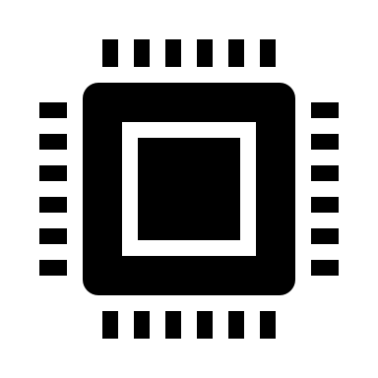

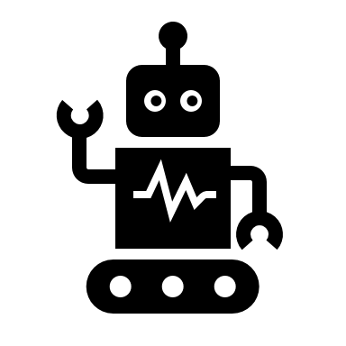
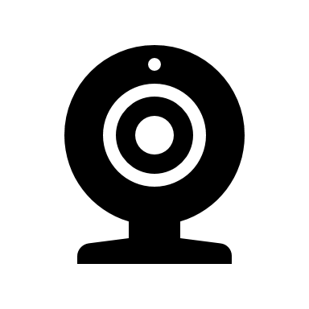
IoT Hub Connectivity Models
Direct over WAN
Protocol gateway
Edge
Devices have public IPv4 & connect to IoT hub directly
Direct from a private network
Devices have private IP
Devices’ traffic pass a net. gateway (e.g., HTTP GW) performing NAT
Devices connect to PG
A special-purpose protocol gateway
Edge runtime deploys & manages devices’ code
PG connects to IoT Hub on behalf of devices with their identity
e.g., connected car
e.g., robots in factory floor
e.g., city street lights
Device talks our supported protocols
Indirect through a field gateway
Devices don’t know any of our supported protocols
Devices connect to a field gateway that supports our protocols
e.g., soil moisture sensors on a farm
e.g., deploy image detection for boxes on a conveyor belt
Usually involves high-powered devices
IoT Hub
IoT Hub
IoT Hub
IoT Hub
IoT Hub
BLE/NFC
Edge device
Factory
Edge
FG
GW
PG
Batching &
Proto translation
On-prem
network
Protocol
translation
AI
AI
WAN

Slide 10
Communication protocols
Protocols
IoT Hub is inherently a message-based cloud-hosted service
Supported protocols are AMQP, MQTT and HTTPS
Devices maintain a persisted connection to IoT Hub
Connections are all TLS-enabled and devices are authenticated
Devices have an IoT Hub identity (SAS key or a certificate)
We allow a special-purpose service-identity with higher privileges, e.g.,
Feature | Device-side protocols | Service-side protocols
D2C telemetry messaging | MQTT/WS + AMQP/WS + HTTPS | AMQP/WS + HTTPS
C2D messaging | MQTT/WS + AMQP/WS + HTTPS | AMQP/WS
Direct methods | MQTT/WS + AMQP/WS | HTTPS
Twin operations | MQTT/WS + AMQP/WS | HTTPS
Device streams | MQTT/WS + AMQP/WS (C/C# SDKs) | AMQP/WS (NodeJS/C# SDK)

Slide 11
Azure IoT Hub SDKs
Multi-language and open-source SDKs – Hosted on Github
Device SDKs enable you to build apps that run on your IoT devices. EX: These apps can send telemetry to your IoT hub, receive messages, methods, twin updates from your IoT Hub, or device registration with your DPS.
C, .NET (C#), Node.js, Java, and Python
Service SDKs enable you to manage your IoT hub and DPS resources. EX: CRUD, send messages, schedule jobs, invoke direct methods, queries, send desired property updates to your IoT devices.
C, .NET (C#), Node.js, Java, iOS and Python
Device Provisioning Service
Provisioning
Device Client
Provisioning
Service Client
IoT Hub
IoT Hub
Device Client
IoT Hub
Service Client
PnP/DT
Device Client
PnP/DT
Service Client

Slide 12
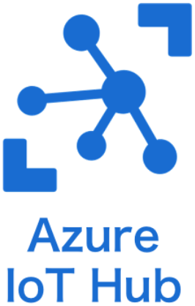
Our story for Embedded
Scenario 1 – C SDK
(Linux – Windows)
Scenario 2 – new Embedded C SDK
(Bare Metal - Constrained devices)
Scenario 3 – Azure RTOS + Azure IoT middleware
(RTOS-based Constrained devices)
Application Code
Telemetry (D2C), C2D,
Device Twin, IoT Plug and Play, Direct Methods
Device Provisioning
Application Code
C SDK
Azure RTOS
IOTHUB Client
Application Code
Embedded C SDK
Azure IoT middleware
Emb. C SDK
Transport
HTTP
MQTT
AMQP
Paho
Mosquitto
etc.
MQTT
MQTT
Transport Client
Netx Duo
Open SSL
Schannel
etc.
TLS
TLS
TLS
Netx Duo
Open SSL
Schannel
Mbed TLS
Win 32
Berkeley
etc.
Socket
Socket
Socket
Netx Duo
Win 32
Berkeley
Mbed
IoT Developer’s responsibility
Microsoft’s responsibility
Notes:
The Azure IoT device SDK for C is a set of libraries designed to simplify the process of sending messages to and receiving messages from the Azure IoT Hub service. The Azure IoT device SDK for C is written in ANSI C (C99) to maximize portability. This feature makes the libraries well suited to operate on multiple platforms and devices, especially where minimizing disk and memory footprint is a priority. As a result, you can optimize for size, choose the connections you want, and take advantage of an “Everywhere SDK”—that is, one that can be used as you need, when you need.
This slide shows the difference between the C SDK (Scenario 1) and the Embedded C SDK (Scenario 2).
Scenario 1 provides everything the developer needs to get his application connected to Azure IoT Hub. It behaves like a platform and provides lots of functionalities.
However this comes at a cost: the tradeoff here is the size. We can’t fit the C SDK in smaller devices.
Scenario 2 addresses that need: it provides developer with the maximum flexibility and the BYO (bring your own) network stack.
Embedded C SDK in this scenario is a set of libraries that helps the developer but requires additional components to work.

Slide 13




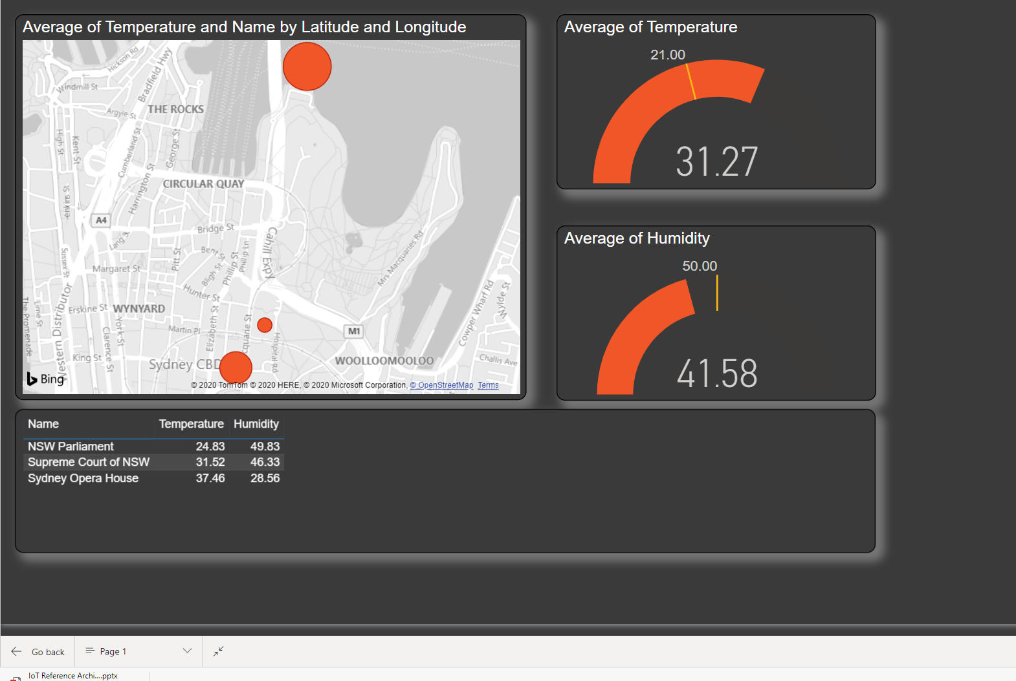
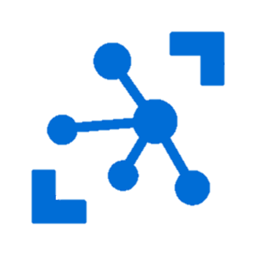


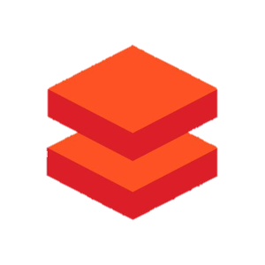


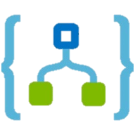
IoT Data: Azure IoT Smart Factory Architecture Scenario
Things
Insights
Actions
Storage
(Cold path)
Stream
processing
Cloud gateway
Azure IoT Hub
Stream Analytics
Message enrichment
Message partitioning
Cosmos DB
(Warm path)
Power BI
IoT Devices
HVAC msgs
Databricks
Azure Synapse
Security msgs
Device
twins
Databricks
Azure Functions
Lighting msgs
Event Hubs
Logic Apps
Notes:
Let's make the IoT Data architecture more concreate
And look how you would implement an Azure IoT solution to support a Smart Factory
The pattern and the services would be very similar for other scenarios
There is a lot going on
Break it down piece by piece to help you understand what is going on
Azure IoT hub is an internet scale secure messaging services, supports bidirectional communications, message enrichment and partitioning
Common services for Stream processing include Stream Analytics, Apache Spark streaming with Azure Databricks, and Azure Functions
And common endpoints include…
Actions and
Starting on the left
Databricks Unified Analytics Platform

Slide 14
Azure IoT Hub Message
{
"body": {
"Temperature": "30.25",
"Humidity": "54.0",
"Pressure": "1021.8"
},
"properties": {
"appid": "hvac",
"type": "telemetry",
"format": "json",
"version": "1",
"latitude": "-33.8767984",
"longitude": "151.2083053",
"name": "Sydney Factory"
}
}
{
"body": {
"Temperature": "30.25",
"Humidity": "54.0",
"Pressure": "1021.8"
},
"properties": {
"appid": "hvac",
"type": "telemetry",
"format": "json",
"version": "1",
}
}
Azure IoT Hub
Device twin
IoT Devices
Device twin document
"tags": {
"deploymentLocation": {
"name": "Sydney Factory",
"longitude": 151.2152,
"latitude": -33.85671,
}
Notes:
Device-to-cloud communications & Cloud to device comms
When sending information from the device app to the solution back end, IoT Hub exposes three options:
Device-to-cloud messages for time series telemetry and alerts.
Device twin's reported properties for reporting device state information such as available capabilities, conditions, or the state of long-running workflows. For example, configuration and software updates.
File uploads for media files and large telemetry batches uploaded by intermittently connected devices or compressed to save bandwidth.
Message comes into IoT Hub
In our example we have a telemetry message from a device
When the code was written for the device the developer can add known metadata
But the developer is unlikely to know where the device is being deployed or what the preferred device name will be
Every device registered has a device twin JSON metadata document
The initial state can be set by the device provisioning service and your application
This JSON document includes tags – data about the device, and desired and reported properties
Tags can include arbitrary data – in our case the device lat/long location and the device name
The device twin tag can be added to the message metadata as it flows through the system
So we now have richer information about the message will be useful as the message flows through the system.

Slide 15
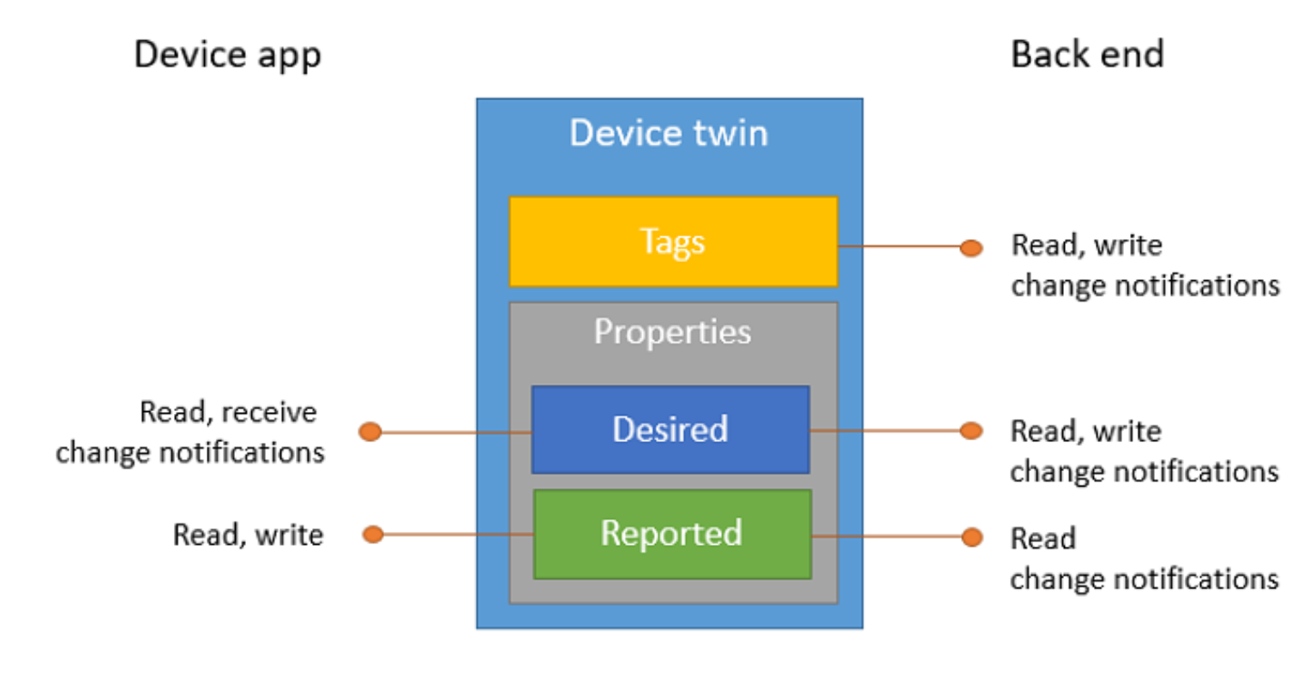
Device Twin
{
"deviceId": "devA",
"authenticationType": "sas",
},
"version": 2,
"tags": {
"deploymentLocation": {
"name": "Sydney Factory",
"longitude": 151.2152,
"latitude": -33.85671,
}
},
"properties": {
"desired": {
"telemetryConfig": {
"sendFrequency": "5m"
},
"$metadata" : {...},
"$version": 1
},
"reported": {
"telemetryConfig": {
"sendFrequency": "5m",
"status": "success"
},
"batteryLevel": 55,
"$metadata" : {...},
"$version": 4
}
}
}
Device Twin
Bi-directional device<->hub communication channel
Based on per-device (per module) json documents
Used to store configuration and control-plane state
Supports queries
Device Twin sections
Tags: set by service and not viewable by device
Desired properties: set by service and delivered to device
Reported properties: set by devices and delivered to service
Tags
Desired properties
Reported properties
Notes:
Device twins are JSON documents that store device state information including metadata, configurations, and conditions. Azure IoT Hub maintains a device twin for each device that you connect to IoT Hub.
The lifecycle of a device twin is linked to the corresponding device identity. Device twins are implicitly created and deleted when a device identity is created or deleted in IoT Hub.
Device twins store device-related information that:
Device and back ends can use to synchronize device conditions and configuration.
The solution back end can use to query and target long-running operations.
The lifecycle of a device twin is linked to the corresponding device identity. Device twins are implicitly created and deleted when a device identity is created or deleted in IoT Hub.
A device twin is a JSON document that includes:
Tags. A section of the JSON document that the solution back end can read from and write to. Tags are not visible to device apps.
Desired properties. Used along with reported properties to synchronize device configuration or conditions. The solution back end can set desired properties, and the device app can read them. The device app can also receive notifications of changes in the desired properties.
Reported properties. Used along with desired properties to synchronize device configuration or conditions. The device app can set reported properties, and the solution back end can read and query them.
Device identity properties. The root of the device twin JSON document contains the read-only properties from the corresponding device identity stored in the identity registry. Properties connectionStateUpdatedTime and generationId will not be included.
This article describes:
The structure of the device twin: tags, desired and reported properties.
The operations that device apps and back ends can perform on device twins.
Use device twins to:
Store device-specific metadata in the cloud. For example, the deployment location of a vending machine.
Report current state information such as available capabilities and conditions from your device app. For example, a device is connected to your IoT hub over cellular or WiFi.
Synchronize the state of long-running workflows between device app and back-end app. For example, when the solution back end specifies the new firmware version to install, and the device app reports the various stages of the update process.

Slide 16
Cloud-to-device communications
IoT Hub provides three options for device apps to expose functionality to a back-end app:
Direct methods for communications that require immediate confirmation of the result.
Twin's desired properties for long-running commands intended to put the device into a certain desired state.
Cloud-to-device messages for one-way notifications to the device app.
Notes:
Data Flow
Direct methods for communications that require immediate confirmation of the result.
Direct methods are often used for interactive control of devices such as turning on a fan.
Twin's desired properties for long-running commands intended to put the device into a certain desired state.
For example, set the telemetry send interval to 30 minutes.
Cloud-to-device messages for one-way notifications to the device app.
Direct Methods: Two-way. The device app can respond to the method right away. The solution back end receives the outcome contextually to the request.
Twin's desired properties: One-way. The device app receives a notification with the property change.
Cloud to device messages: One-way. The device app receives the message

Slide 17
Azure IoT Hub Messaging Routing and Partitioning
Azure IoT Hub
Endpoint Partitioning
Message partitioning
{
"body": {
"Temperature": "30.25",
"Humidity": "54.0",
"Pressure": "1021.8"
},
"properties": {
"appid": "hvac",
"type": "telemetry",
"format": "json",
"version": "1",
"latitude": "-33.8767984",
"longitude": "151.208305",
"name": "Sydney Factory"
}
}
Rules based message routing
appid = 'hvac’
and
type = 'telemetry'
HVAC telemetry Event hub
HVAC msgs
Security telemetry
Event hub
Security msgs
Lighting telemetry
Event hub
Lighting msgs
Audit cold path
Azure storage
Notes:
Use IoT Hub message routing to send device-to-cloud messages to different endpoints
Our system must deal with messages arriving from a range of devices
There could be telemetry messages arrive HVAC systems, security sensors, lighting systems etc
Each message will have a different format, different time vale, destined for different back end systems etc
Now there are two patterns you could deploy to deal with this complexity
Now we could have 1 IoT hub per device type and application but that would quickly become expensive and difficult to manage
Or more likely you have a consolidated set of IoT hubs and as messages flow into the system you will partition the messages ideally based on metadata but if JSON serialised message then you can also use the body of the message to route messages.
I’m going to assume you will most like what you use a consolidated set of IoT Hubs and route the messages
To that end IoT hub includes the alibility to route messages to different endpoints typically based on application, but could also include logging all messages entering the system for audit
An IoT hub has a default built-in-endpoint (messages/events) that is compatible with Event Hubs. You can create custom endpoints to route messages to by linking other services in your subscription to the IoT Hub.
Message enrichments describes the ability of Azure IoT Hub to stamp messages with additional information before the messages are sent to the designated endpoint.
IoT Hub currently supports the following endpoints:
Built-in endpoint
Azure Storage
Service Bus Queues and Service Bus Topics
Event Hubs
There are two storage services IoT Hub can route messages to -- Azure Blob Storage and Azure Data Lake Storage Gen2 (ADLS Gen2) accounts. Azure Data Lake Storage accounts are hierarchical namespace-enabled storage accounts built on top of blob storage. Both of these use blobs for their storage.
Non-telemetry events
In addition to device telemetry, message routing also enables sending device twin change events, device lifecycle events, and digital twin change events. For example, if a route is created with data source set to device twin change events, IoT Hub sends messages to the endpoint that contain the change in the device twin. Similarly, if a route is created with data source set to device lifecycle events, IoT Hub sends a message indicating whether the device was deleted or created.

Slide 18
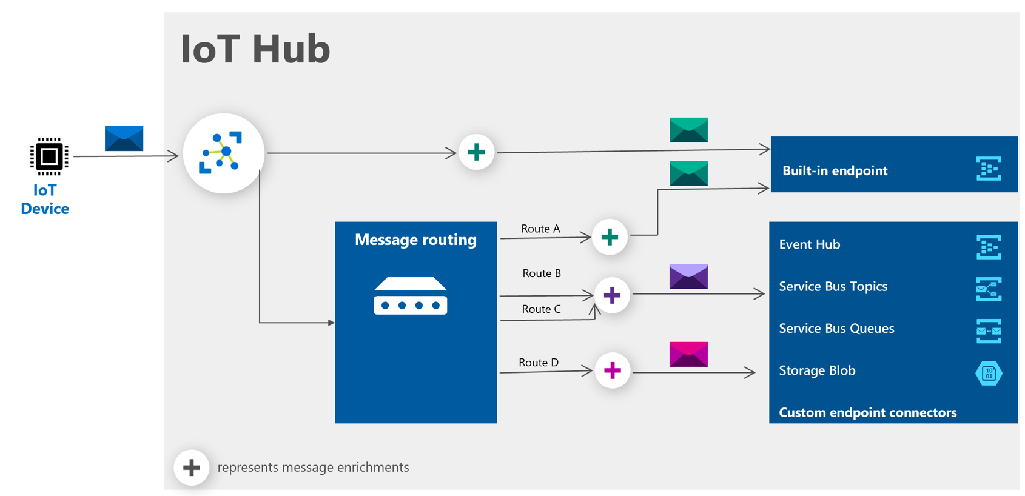
IoT Hub Message Routing and Message Enrichments
Enrichment Values supported
Device Twin tags, properties
IoT Hub name
Static string
Notes:
An IoT hub has a default built-in-endpoint (messages/events) that is compatible with Event Hubs. You can create custom endpoints to route messages to by linking other services in your subscription to the IoT Hub.
Message enrichments describes the ability of Azure IoT Hub to stamp messages with additional information before the messages are sent to the designated endpoint.
IoT Hub currently supports the following endpoints:
Built-in endpoint
Azure Storage
Service Bus Queues and Service Bus Topics
Event Hubs
There are two storage services IoT Hub can route messages to -- Azure Blob Storage and Azure Data Lake Storage Gen2 (ADLS Gen2) accounts. Azure Data Lake Storage accounts are hierarchical namespace-enabled storage accounts built on top of blob storage. Both of these use blobs for their storage.
Non-telemetry events
In addition to device telemetry, message routing also enables sending device twin change events, device lifecycle events, and digital twin change events. For example, if a route is created with data source set to device twin change events, IoT Hub sends messages to the endpoint that contain the change in the device twin. Similarly, if a route is created with data source set to device lifecycle events, IoT Hub sends a message indicating whether the device was deleted or created.

Slide 19
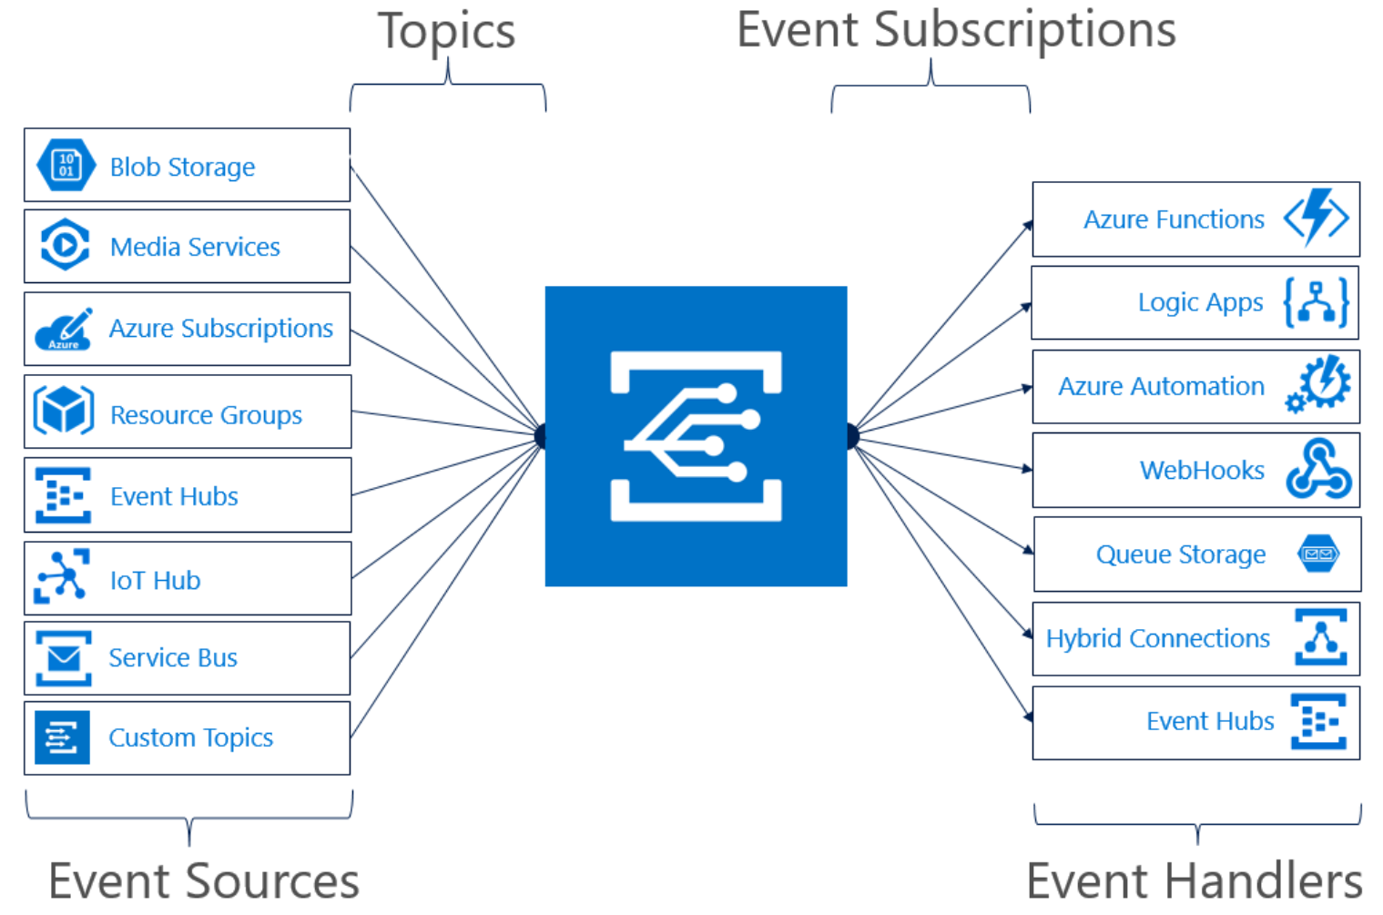
Serverless Integration
Events supported:
Device Telemetry
Device Created/Deleted Events
Device Connected/Disconnected Events
Notes:
Azure IoT Hub integrates with Azure Event Grid so that you can send event notifications to other services and trigger downstream processes.
For example: If I wanted to create an alert to send an email whenever a new device is created, I could create a Logic App and IoT Hub event subscriptions
Filter events
IoT Hub event subscriptions can filter events based on event type, data content and subject, which is the device name.

Slide 20

NEW: Device Update for IoT Hub
is an end-to-end platform for publishing, distributing, and managing over-the-air updates for IoT devices – from tiny sensors to gateway-level modules
Notes:
To address these key customer pain-points, we are expanding the management capabilities provided to you by Azure IoT platform, by introducing the new Device Update for IoT Hub.
Device Update for IoT Hub is an end-to-end platform for IoT device builders and solution integrators who want their customers to get the most value from their Azure IoT-enabled products. The platform simplifies and accelerates the time-consuming task of keeping every device across an IoT ecosystem up to date with the latest security and feature updates.
----------
Device Update for IoT Hub provides an on-network caching solution to enable updating of more complex topologies involving internet-isolated leaf and Nested Edge devices and is compatible with open-source solutions. It implements robust security measures for a safe updating experience, while rich management controls and reporting ensure that customers stay in control of the update process.
Device Builders: Whether you or your customers will be responsible for updating the devices you sell, you can make your IoT products more compelling for potential customers by preinstalling Device Update for IoT Hub so keeping devices updated is simple, secure, and reliable.
Solution Integrators & Device Builders: If you manage or deploy updates for customers, Device Update for IoT Hub has the capabilities you need to rapidly deploy over-the-air updates for everything from tiny sensor devices to gateway-level devices.

Slide 21





Device Update for IoT Hub Robust features for every IoT ecosystem
APIs make it easy to build your own portals and clients
Seamless UX Integration with Azure IoT Hub
Broad support for IoT operating systems, extensible via open source
Microsoft Connected Cache enables you to easily update devices downstream of a gateway and in nested topologies
Robust scheduling, notification, and reporting tools help keep you informed and in control
Notes:
Let's take a look at the features that are provided with Device Update-
Device Update provides APIs for importing, distributing and managing updates, so partners can choose to build their own custom portal and experiences on top of it
We also provide a seamless UX experience in Azure Portal integrated with IoT Hub
There is broad support for various IoT operating systems like Linux, Azure RTOS and platforms like Azure IoT Edge and Azure Percept. All of our agents are completely open-source so they can be extended to any configuration that you have running in your ecosystem
A unique offering of Device Update is the in-built support for Microsoft Connected Cache that enables updates for cloud disconnected devices downstream of an Edge gateway as well as in nested topologies
And lastly, Device update provides robust management and reporting tools that help keep customers informed and in control of the update process

Slide 22

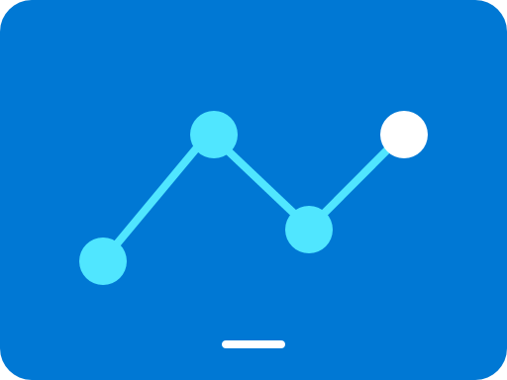



How Device Update for IoT Hub works in the real world
8.
View reporting
7.
6.
Deploy and monitor updates
5.
Import updates
IoT Hub
4.
Group devices
Device Update
3.
Provision devices with Device Update agent
Easily connect
2.
Manage access
1.
Subscribe
Notes:
Now let's take a look at how you can get started with Device Update for IoT Hub.
You can provision the Device Update resource from the Azure Marketplace on a new or existing Azure subscription. Provide access to different users or groups within your organization to the platform. You can connect a Device Update instance to a new or existing IoT Hub. Next, you have to install and provision the device update agent on your IoT device. You can use IoT Hub tags to group various devices which enable you to gradually deploy your update. For example you may group devices based on whether they are test or production, based on the region where they are deployed etc. Next import an update into your Device Update instance and then schedule a deployment to the group of devices you created above. You can then monitor the status to discover which of your devices are compliant with the latest update and which devices are not.
Subscribe – Select a subscription and provision the platform. A free introductory trial is available
Manage access – Select the people you want to have the ability to provision or access the platform
Easily connect – Select the IoT Hub instance you want to manage
Provision devices with Device Update agent – Quickly integrate Device Update for IoT Hub capabilities into your client software
Group devices – Group devices by class and schedule when updates occur.
Import updates – Import the security or new feature updates you require.
Deploy and monitor updates – Push security or feature updates to devices and receive real-time status notifications
View reporting – Robust reporting capabilities make it easy to keep track of updates and provide up-to-date documentation
New users can get started by going to Azure.com, which has detailed information about the service. New users who want to try out Device Update for Azure IoT Hub can use a free tier without being charged up to a defined threshold. Solution operators are then able to select a resource group and region and then specify the name of the Device Update for Azure IoT Hub resource instance and the Azure AD directory to be associated with this instance. The user can subsequently see the status of the update being provisioned and then manage the update once provisioning is complete. IoT solution operators and team leaders can select who is given Device Update for Azure IoT Hub provisioning access within their organizations, as well as specifying the users who can manage update instances, try out the functionality, and who can publish or deploy updates.
Included with Device Update for Azure IoT Hub are features that allow maximum flexibility for updating devices:
Use information in Azure IoT Hub to enable a “cloud scan” or cloud orchestrator, where applicability and workflow is moved to the cloud rather than requiring on-device scans.
Automatically match updates imported into the system with compatible devices, making it easy to deploy the right updates to the right devices.
Easily subscribe to Device Update for Azure IoT Hub services through the Azure.com portal and provision update tenants.
Built-in capability to update cloud disconnected devices using an IoT Edge module called Microsoft Connected Cache. This allows disconnected devices to seamlessly download cloud-hosted update payload.

Slide 23
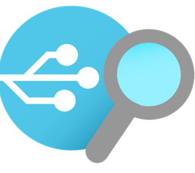
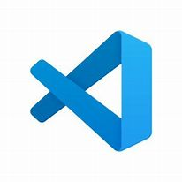
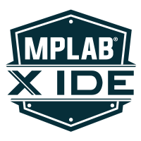
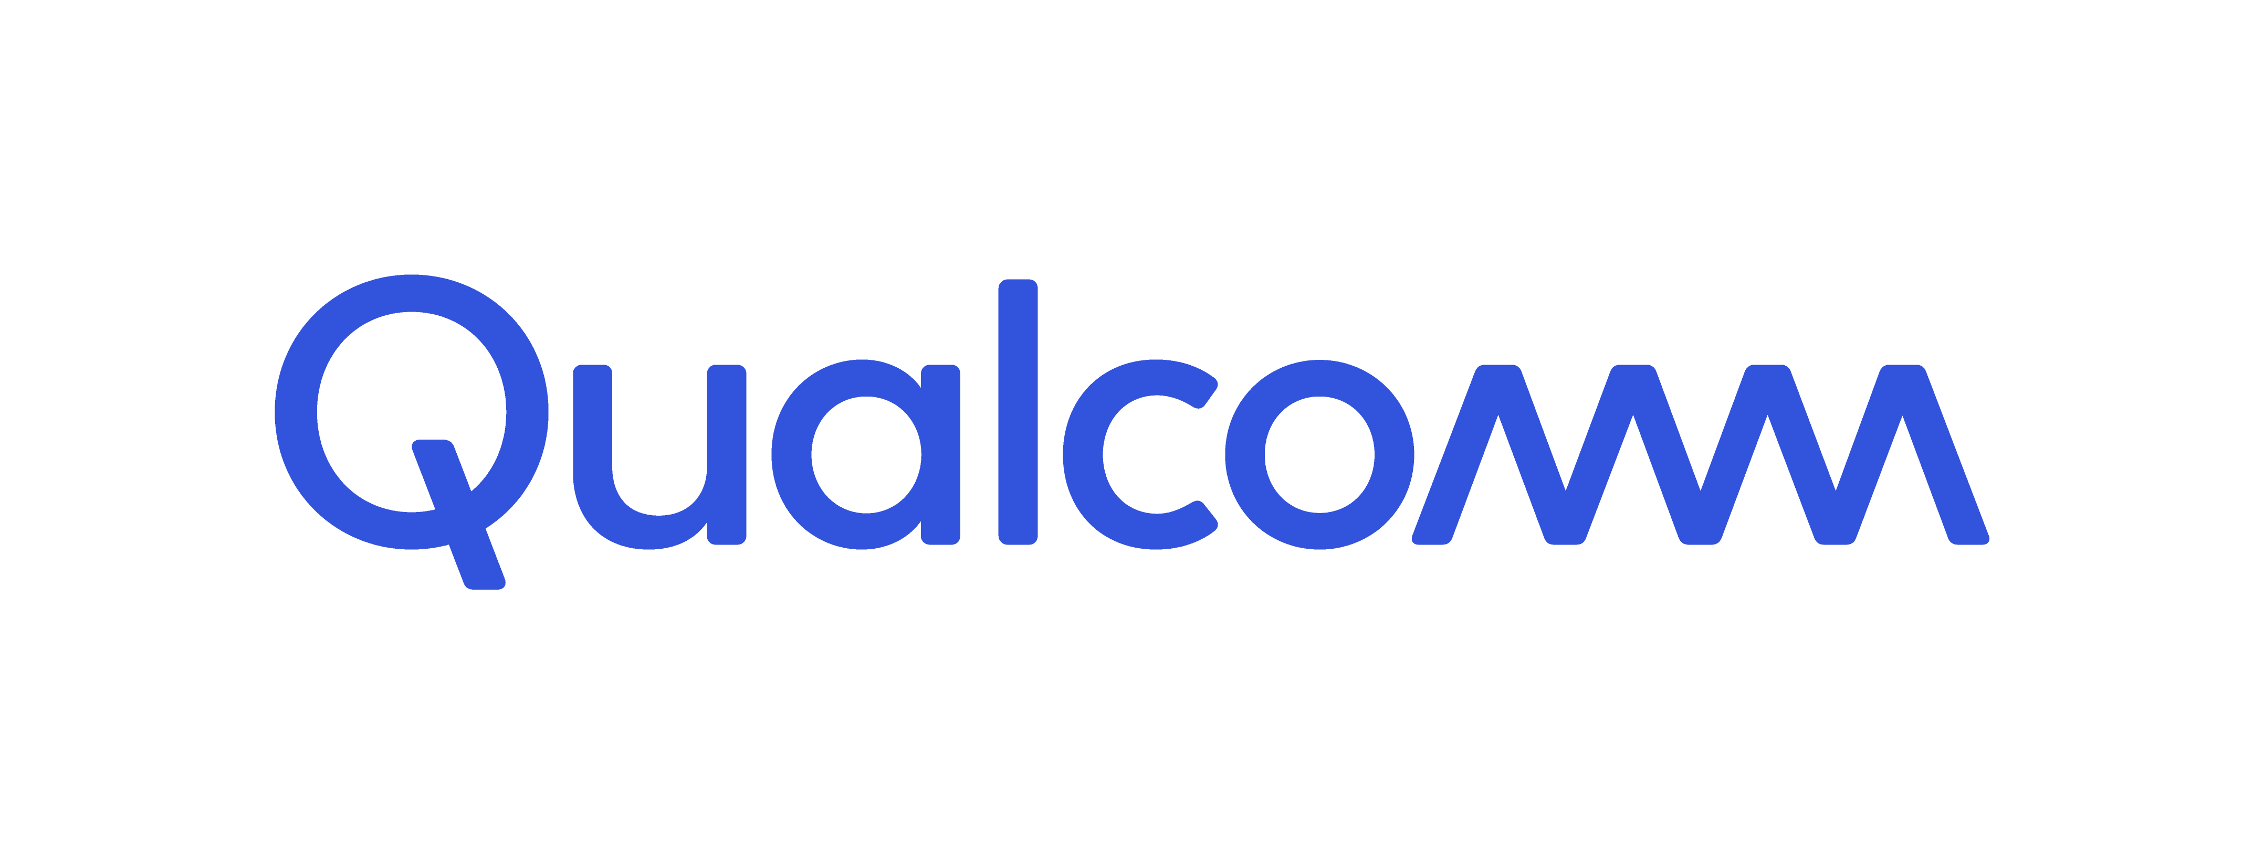




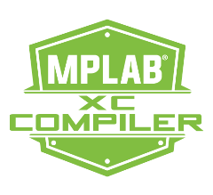
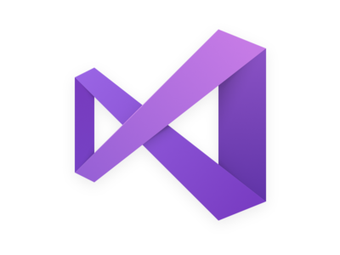

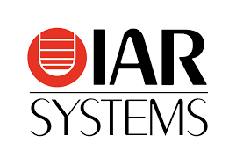
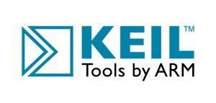





Simplifying IoT with developer tools
Azure IoT Explorer
Graphical tool for interacting with and testing your IoT devices
VS Code
Azure IoT Tools Extension Pack
Visual Studio
Azure IoT Hub & IoT Edge Support
Azure IoT CLI extension
Open-source cross platform command-line tool for managing Azure resources such as IoT Hub
Vendor Tooling
Samples with Azure RTOS, Embedded C SDK, IoT Plug and Play

Slide 24
Demo

Slide 25
Resources
Notes:
ELP videos/presentation decks, MS Learn and Learn Paths, Instructor Led Training options, AZ220 Study Guide blog, IoT Demo GitHub and ultimately encouraging people to sign up for the 30 Days to Learn it challenge to earn 50% off the certification.

Slide 26

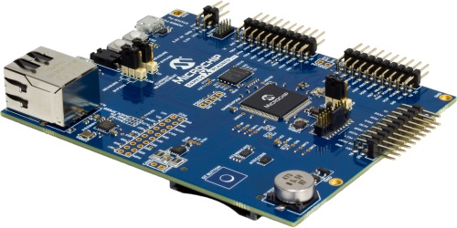
Azure RTOS – Connecting devices to the cloud
MCU Device
Azure Cloud
Azure RTOS
Embedded C SDK
IoT Hub
Device to Cloud
& Cloud to Device
IoT Central
Device Provisioning Service
Azure IoT
Hub
Custom Solution
https://github.com/azure-rtos
https://aka.ms/deepdive/eMASTERs-Microchip-Microsoft-Connecting-Devices
Notes:
Enable highly secure and reliable communication between your Internet of Things (IoT) application and the devices it manages. Azure IoT Hub provides a cloud-hosted solution back end to connect virtually any device. Extend your solution from the cloud to the edge with per-device authentication, built-in device management, and scaled provisioning.

Slide 27
http://aka.ms/EmbeddedDevResearch
Notes:
ELP videos/presentation decks, MS Learn and Learn Paths, Instructor Led Training options, AZ220 Study Guide blog, IoT Demo GitHub and ultimately encouraging people to sign up for the 30 Days to Learn it challenge to earn 50% off the certification.

Slide 28

30 Days to Learn Cloud Skills Challenge
’30 Days to Learn it’ offers a time-bound, personalized, Cloud Skills Challenge that is built upon Microsoft Learn. It is designed to help developers build in-demand skills that advance their career, while preparing them to earn the Microsoft Certification for the Azure IoT Developer (AZ220) exam.
https://aka.ms/30DaysCSC/IoT
Notes:
ELP videos/presentation decks, MS Learn and Learn Paths, Instructor Led Training options, AZ220 Study Guide blog, IoT Demo GitHub and ultimately encouraging people to sign up for the 30 Days to Learn it challenge to earn 50% off the certification.
Aka.ms/30dayscsc

Slide 29
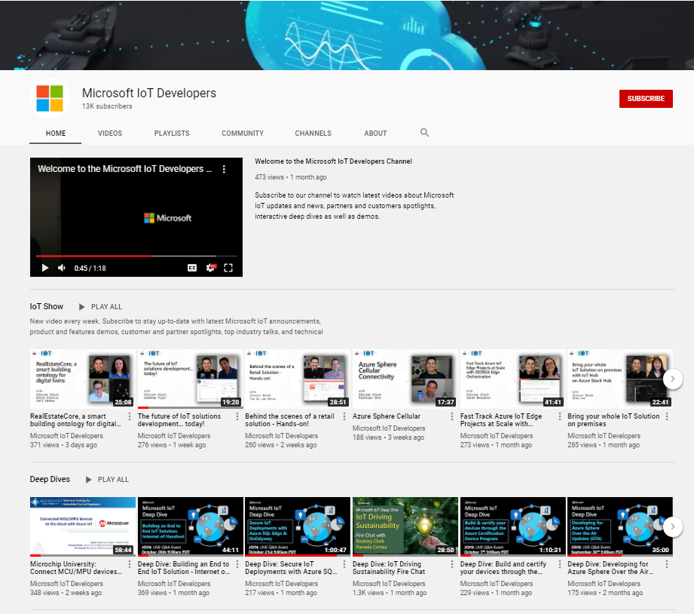
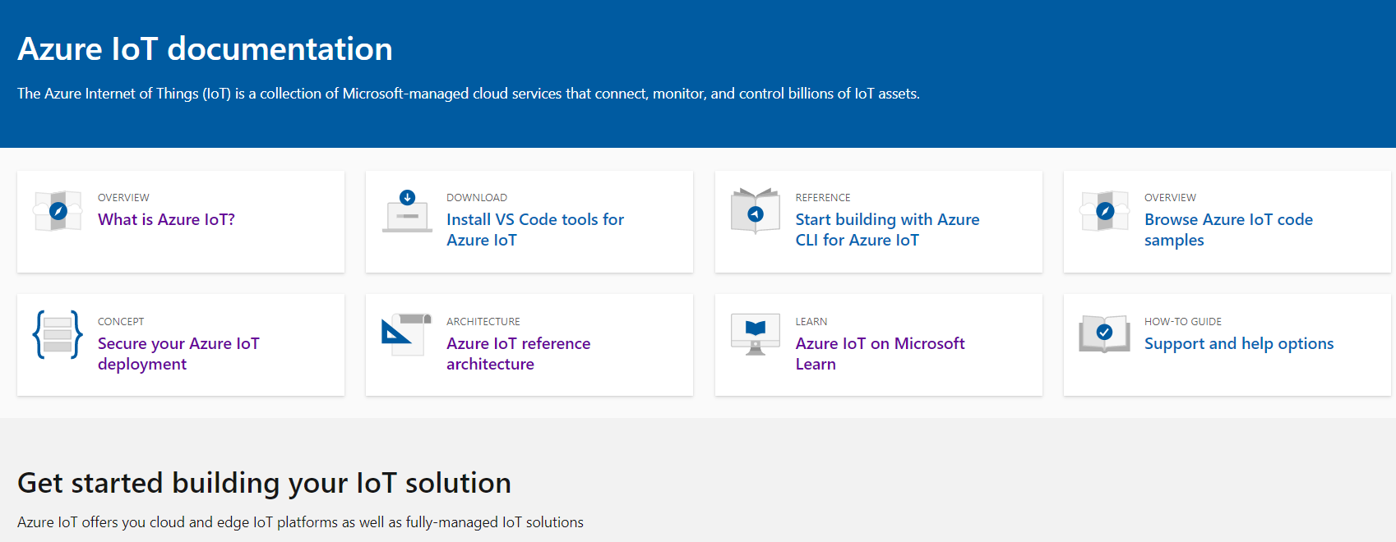
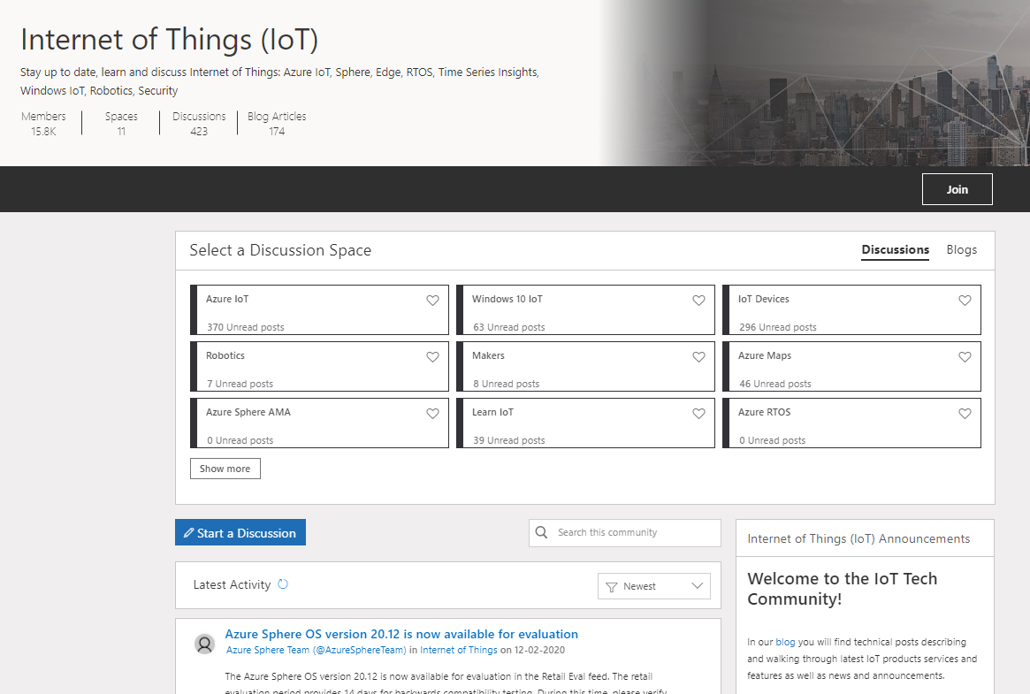
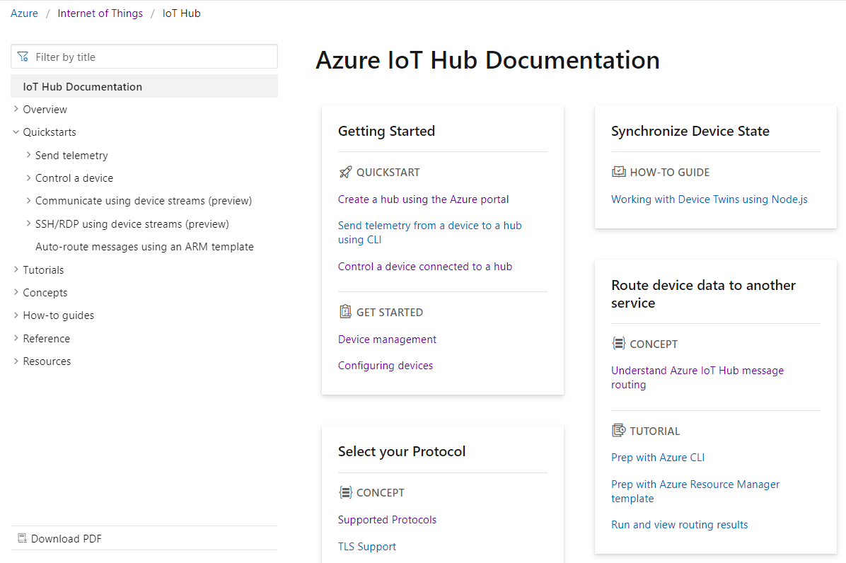

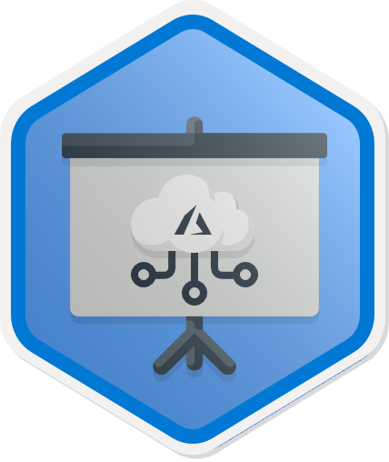
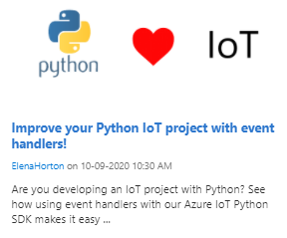
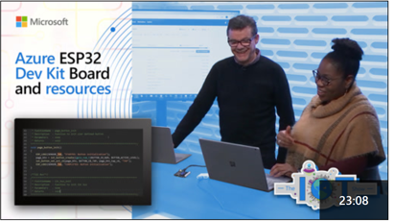
Start upskilling on Azure IoT today!
Hands on Learning | Watch | Discover and Discuss | Get Started Building
Microsoft Learn | Microsoft IoT Developers Channel | IoT Tech Community | Azure IoT Docs
https://aka.ms/mslearniot | https://aka.ms/msiotdevs | https://aka.ms/iottechcommunity | https://docs.microsoft.com/en-us/azure/iot-fundamentals/
MS Learn is the go-to site for self-paced, step-by-step learning. We offer over 40+ individual learn modules covering products such as Azure IoT Hub, IoT Edge, Digital Twins, and more. | Watch and learn about our products! View Deep Dives for deep technical learning. | Check out the blog to find technical posts describing and walking through latest IoT products services and features as well as news and announcements. | Check out the quick starts, how-to guides, and tutorials on Azure IoT Docs to learn how to build your IoT solutions.
https://aka.ms/IntroAzureIoTLearningPath
Notes:
Additionally, MS Learn offers 8 Learning Paths designed to help with certification exam prep as well as deeper concepts targeted at different roles including IoT developer, data engineer, solution architect, and administrator.
ELP videos/presentation decks, MS Learn and Learn Paths, Instructor Led Training options, AZ220 Study Guide blog, IoT Demo GitHub and ultimately encouraging people to sign up for the 30 Days to Learn it challenge to earn 50% off the certification.
Aka.ms/30dayscsc

Slide 30
Live Q&A Thank you! IoT Arch Reference: https://aka.ms/iotrefarchitecture Azure Account Signup: https://aka.ms/get-started-azure-2021 Azure IoT Central: https://apps.azureiotcentral.com/myapps Cloud Skills Challenge: https://aka.ms/30DaysCSC/IoT MS Learn: https://aka.ms/mslearniot MSFT IoT Developer Video Channel: https://aka.ms/msiotdevs IoT Tech Community: https://aka.ms/iottechcommunity Azure IoT Docs: https://docs.microsoft.com/en-us/azure/iot-fundamentals/
Notes:
ELP videos/presentation decks, MS Learn and Learn Paths, Instructor Led Training options, AZ220 Study Guide blog, IoT Demo GitHub and ultimately encouraging people to sign up for the 30 Days to Learn it challenge to earn 50% off the certification.

